Slide 1

LECTURE SERIES
THE
EVOLUTION
OF ROCK
A Journey Through the History of Rock 'n' Roll

Slide 2
NAVIGATION
CONTENTS
01
Origins & Birth of Rock
02
The British Invasion
1940s-1950s: The Musical Fusion That Changed Everything
1960s: When Britain Took Back American Music
03
Classic Rock & Hard Rock
04
Birth of Heavy Metal
Late 1960s-1970s: The Golden Age of Rock
Late 1960s-1970s: The Unholy Trinity
05
Punk Rock & New Wave
06
Alternative Rock & Grunge
1970s-1980s: Raw Energy & Artistic Expression
1990s: The Seattle Sound Goes Global
07
Indie Rock Revival
08
Legacy & Cultural Impact
2000s-2010s: Return to Raw, DIY Aesthetics
Rock's Enduring Influence on Music & Culture

Slide 3
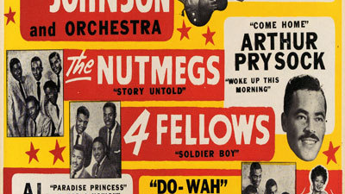
01
CHAPTER ONE
ORIGINS &
BIRTH OF ROCK
1940s-1950s: The Musical Fusion That Changed Everything

Slide 4
CHAPTER 01
The Roots of Rock: Blues, Gospel & Country
African American Blues
The blues emerged in the late 19th century in the Mississippi Delta, rooted in African American experiences of struggle and resilience. Early blues was primarily call-and-response vocal music, evolving from field shouts and hollers into passionate solo songs.
The Perfect Storm
Legendary artists like Robert Johnson , Muddy Waters , and B.B. King established the guitar as the dominant instrument, creating the foundation for rock's signature sound.
Post-war America created the cultural conditions for these diverse musical traditions to merge. The migration of African Americans to Northern cities brought blues and gospel to new audiences, while radio and records allowed cross-cultural pollination.
Gospel Spirituals
Gospel music evolved from spirituals and blues , maintaining the call-and-response tradition rooted in African music. Modern gospel began in African American churches in the 1920s, with composers like Thomas A. Dorsey blending blues and jazz elements with traditional hymns.
The emotional intensity and vocal power of gospel would profoundly influence rock singers, from Little Richard 's ecstatic performances to Aretha Franklin 's soulful delivery.
Key Innovation
Country & Folk Traditions
The electric guitar replaced the saxophone as the central soloing instrument, thanks to pioneers like Chuck Berry and Bo Diddley in the mid-1950s.
Country music, originating in the 1920s Southern U.S. , brought storytelling lyrics and simple melodies to the rock equation. The twang of the guitar and narrative songwriting style would merge with blues intensity to create rockabilly and early rock 'n' roll.

Slide 5
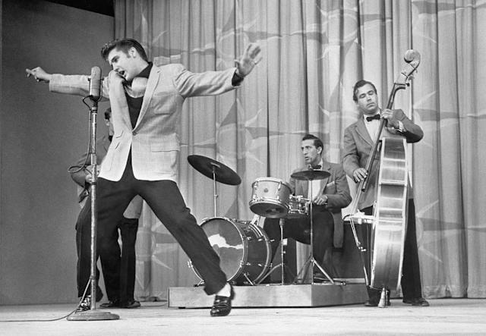
CHAPTER 01
Rock 'n' Roll Is Born: The 1950s Revolution
The Birth of a Genre
Rock music emerged in the mid-1950s, characterized by hard-edged music performed with electric guitars, bass, and drums, accompanied by lyrics sung by a vocalist. This new sound was aided by electric guitars and a steady drumbeat, creating an aggressive attack that suggested sexual freedom in a conservative age.
Unlike the safe pop music of the era, rock's raw energy and rebellious spirit captured the imagination of teenagers seeking something authentic and exciting.
Pioneering Artists
Elvis Presley
The King of Rock 'n' Roll, blending country, blues, and gospel into an irresistible sound
Chuck Berry
Leaned heavily on classic blues structures while demonstrating natural-born showmanship
1950s PERFORMANCE
Elvis Presley on Stage
Little Richard
Brought ecstatic, gospel-influenced vocals and piano-driven energy
Buddy Holly
1954
1955
1955
Pioneered the standard rock band lineup with guitar, bass, and drums
"That's All Right"
Elvis's debut
"Maybellene"
Chuck Berry
"Tutti Frutti"
Little Richard
Cultural Impact
Rock 'n' roll became the voice of youth rebellion, challenging racial segregation by bringing black and white audiences together. The music's energy and attitude would inspire generations of musicians in England and America to pick up guitars and form bands.

Slide 6
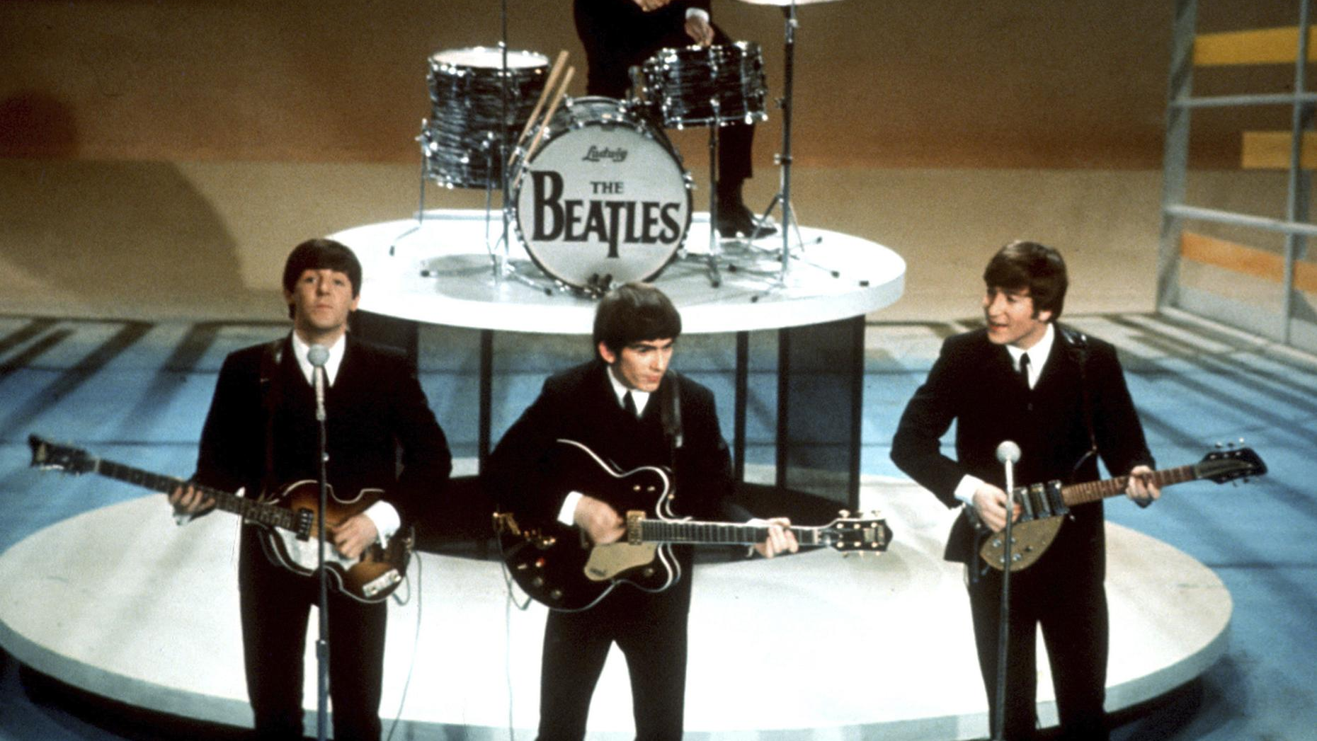
02
CHAPTER TWO
THE BRITISH
INVASION
1960s: When Britain Took Back American Music

Slide 7
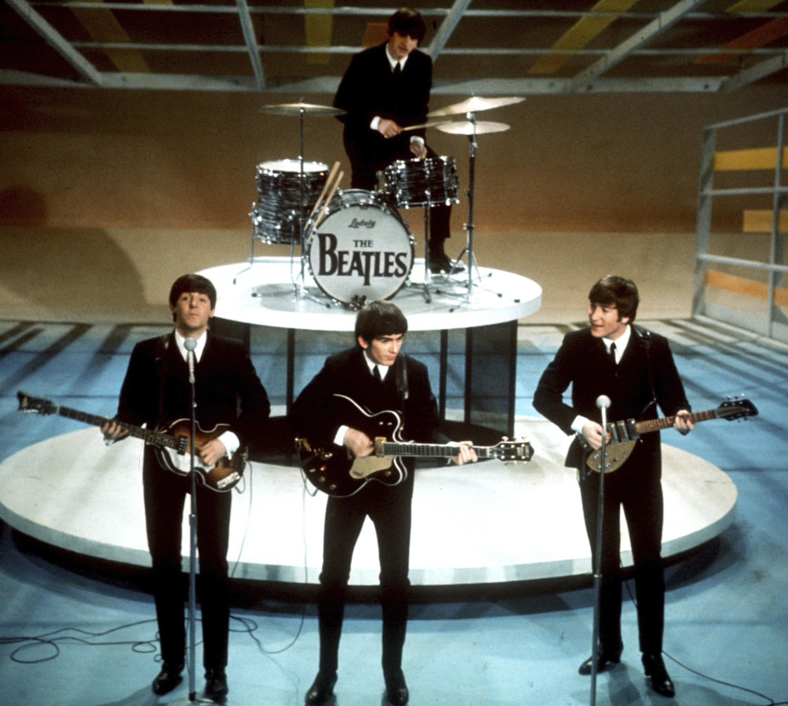
CHAPTER 02
Beatlemania & The British Invasion
The Ed Sullivan Show: February 9, 1964
73 million Americans watched as The Beatles made their historic U.S. television debut. This moment marked the beginning of "Beatlemania" and the British Invasion—a cultural phenomenon that would transform American music forever.
Ed Sullivan had witnessed the frenzy firsthand at London airport weeks earlier, where thousands of fans screamed for The Beatles. Realizing their potential impact, he invited them to his show, unknowingly igniting a musical revolution.
Two Cities, Two Sounds
Liverpool
London
The port city embraced American rock and roll from sailors bringing records. Skiffle music—combining folk, jazz, country and blues—provided the backdrop. This produced upbeat, melodic Merseybeat exemplified by The Beatles and Gerry & the Pacemakers.
College students and bohemians were drawn to raw American blues and R&B. Artists like Muddy Waters and B.B. King inspired a grittier, blues-infused rock sound exemplified by The Rolling Stones and The Yardbirds.
1964
The Beatles on Ed Sullivan
Cultural Revolution
Fashion: Mod style, mop-top haircuts, tailored suits
Youth Culture: Teenagers found their voice and identity
14
1.92M
73M
Counterculture: Music touched on peace, love, freedom
British singles in
U.S. Top 40 (1965)
"She Loves You"
UK sales
TV viewers for
Ed Sullivan debut
Global Impact: Proved non-American acts could dominate U.S. charts

Slide 8
CHAPTER 02
The Rolling Stones & The London Blues Scene
The Bad Boys of Rock
The British Invasion Timeline
While The Beatles represented wholesome charm, The Rolling Stones brought danger and sexuality to rock. Their scruffy appearance and blues-influenced sound offered a stark contrast to the clean-cut image of early British Invasion bands.
1963
The Beatles release "Please Please Me" and "From Me to You" - first UK #1 hits
1964
February: Beatles on Ed Sullivan. "I Want to Hold Your Hand" tops U.S. charts
By embracing sex and youthful rebellion in their music, The Stones courted controversy but also elevated rock to new cultural heights. They expanded rock's scope by transitioning from singles artists into musicians capable of producing cohesive albums.
1964
Rolling Stones release "(I Can't Get No) Satisfaction" - becomes anthem of rebellion
1965
June 18: 14 British records in U.S. Top 40 - the invasion's peak
1966
Time magazine cover: "London: The Swinging City" - America surrenders
Key British Invasion Bands
The Who
The Invasion's Legacy
Raw energy, power chords, destroyed instruments on stage
The British Invasion proved that British musicians could not only match American artists but surpass them. By 1967, English and American bands were equal partners in one international rock culture. The invasion opened doors for foreign acts and established rock as a global phenomenon.
The Kinks
Innovative songwriting, distorted guitar riffs
The Animals
"House of the Rising Sun" - gritty R&B influence
The Yardbirds
Guitar legends Eric Clapton, Jeff Beck, Jimmy Page

Slide 9

03
CHAPTER THREE
CLASSIC ROCK
& HARD ROCK
Late 1960s-1970s: The Golden Age of Rock

Slide 10

CHAPTER 03
The Rise of Classic Rock
From Singles to Albums
Classic rock emerged in the late 1960s through the 1970s as rock musicians transitioned from singles-oriented artists to album-focused creators. This era saw the birth of Album-Oriented Rock (AOR), where radio stations played not just hit singles but deeper album tracks, allowing for extensive exploration of an artist's catalog.
Classic rock is characterized by its melodic, radio-friendly sound with well-structured songs, catchy hooks, and strong vocal harmonies. It features prominent guitar work and classic rock instrumentation including electric guitars, bass, drums, and keyboards.
Iconic Classic Rock Albums
Led Zeppelin IV
The Dark Side of the Moon
1970s ROCK
Led Zeppelin (1971)
Pink Floyd (1973)
Stadium Rock Era
Features "Stairway to Heaven"
Concept album masterpiece
Hotel California
Who's Next
Musical Characteristics
The Eagles (1976)
The Who (1971)
Melodic hooks and memorable choruses
Title track guitar solo legendary
"Baba O'Riley" & "Won't Get Fooled Again"
Prominent guitar work with solos and riffs
Strong vocal harmonies
Keyboard integration (piano, organ, synthesizers)
Radio-friendly production
Queen
David Bowie
Elton John
Aerosmith

Slide 11
CHAPTER 03
Hard Rock: Louder, Heavier, Faster
The Evolution of Power
Defining Hard Rock Albums
Hard rock emerged as a subgenre that combined the sound and attitude of rock 'n' roll with a heavier, more aggressive approach. It grew out of the blues-based rock and psychedelic rock of the 1960s, pushing the boundaries of volume, distortion, and intensity.
LZ
Physical Graffiti
Led Zeppelin (1975) - Double album masterpiece
Hard rock is characterized by powerful, distorted guitar riffs, strong rhythm sections, and often high-energy, driving tempos. Extended guitar solos became a signature element, showcasing technical virtuosity and emotional expression.
DP
Machine Head
Deep Purple (1972) - "Smoke on the Water"
BS
Paranoid
Black Sabbath (1970) - "Iron Man" & "War Pigs"
Hard Rock Pioneers
Highway to Hell
AC
Led Zeppelin
AC/DC (1979) - Breakthrough album
Jimmy Page's monster riffs and studio wizardry redefined rock guitar
Deep Purple
Key Characteristics
Ritchie Blackmore's classical-influenced guitar mastery
Black Sabbath
Distorted guitar riffs
Powerful rhythm section
Tony Iommi's downtuned, heavy riffs pioneered metal
Extended guitar solos
High-energy tempos
AC/DC
Raw, aggressive sound
Blues-based foundation
Raw, blues-based hard rock with infectious energy

Slide 12
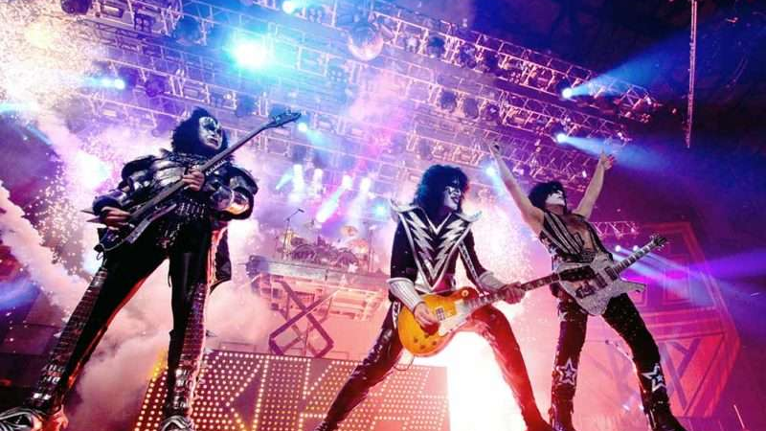
04
CHAPTER FOUR
BIRTH OF
HEAVY METAL
Late 1960s-1970s: The Unholy Trinity

Slide 13

CHAPTER 04
The Three Pillars of Heavy Metal
The Unholy Trinity
In the late 1960s, three British bands emerged that would forge heavy metal: Led Zeppelin, Black Sabbath, and Deep Purple. Often called the "unholy trinity," these pioneering groups crystallized the heavy metal sound and style that would dominate the 1970s and beyond.
Each band contributed unique elements—Led Zeppelin's riff-driven anthems, Black Sabbath's dark and heavy atmosphere, and Deep Purple's technical virtuosity. Together, they established the musical and visual style that would define the genre.
HEAVY METAL
Led Zeppelin
Black Sabbath
Deep Purple
The Birth of a Genre
The Blueprint
The Darkness
The Virtuosos
Formed: 1968, London
Formed: 1968, Birmingham
Formed: 1968, Hertford
Legacy & Influence
Key Members: Jimmy Page, Robert Plant, John Paul Jones, John Bonham
Key Members: Tony Iommi, Ozzy Osbourne, Geezer Butler, Bill Ward
Key Members: Ritchie Blackmore, Ian Gillan, Roger Glover, Jon Lord, Ian Paice
These three bands laid the foundation for all heavy metal that followed. Their influence can be heard in nearly every metal subgenre, from traditional heavy metal to thrash, death, and beyond.
Contribution: Blues-rock fusion, monster riffs, mythological themes
Contribution: Downtuned guitars, occult themes, doom atmosphere
Contribution: Classical influences, technical precision, keyboard-guitar interplay
Iconic Tracks: "Whole Lotta Love," "Stairway to Heaven," "Immigrant Song"
Iconic Tracks: "Paranoid," "Iron Man," "War Pigs"
They established the visual aesthetic—leather, long hair, dark imagery—and the sonic template: distorted guitars, powerful vocals, and thunderous drums. Without them, the world of rock music would be a very different place.
Iconic Tracks: "Smoke on the Water," "Highway Star," "Child in Time"
Pioneered stadium rock and album-oriented approach
Pioneered doom, stoner, and sludge metal subgenres
Brought classical sophistication to heavy rock

Slide 14
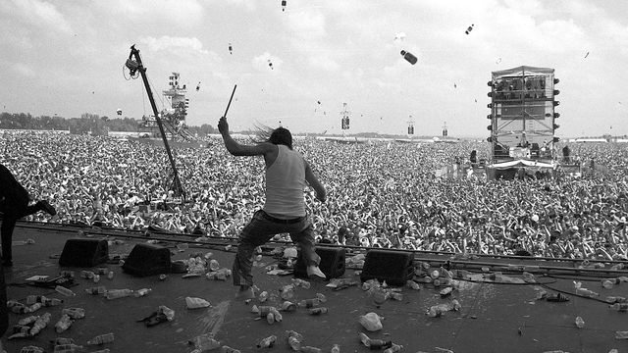
05
CHAPTER FIVE
PUNK ROCK
& NEW WAVE
1970s-1980s: Raw Energy & Artistic Expression

Slide 15
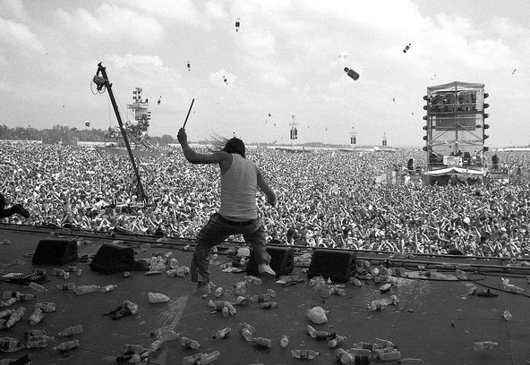
CHAPTER 05
Punk Rock: Three Chords & The Truth
The Revolution of Simplicity
Punk rock emerged in the mid-1970s as a direct reaction against the excesses of progressive rock and the polished production of mainstream music. Stripped down to its essentials, punk championed a DIY ethic—anyone could pick up a guitar, learn three chords, and start a band.
Punk's raw, aggressive sound and anti-establishment lyrics gave voice to disenfranchised youth. It was fast, loud, and unapologetic—a musical revolution that proved you didn't need technical virtuosity to make powerful, meaningful music.
Punk Pioneers
PUNK ENERGY
The Ramones
The Sex Pistols
Raw & Unfiltered
New York, 1974
London, 1975
"Blitzkrieg Bop," "I Wanna Be Sedated" - Fast, catchy, minimalist
"Anarchy in the U.K.," "God Save the Queen" - Provocation incarnate
Cultural Impact
The Clash
Black Flag
Fashion: Safety pins, leather jackets, torn clothes
Attitude: Rebellion, anti-authoritarianism
London, 1976
California, 1976
DIY Culture: Independent labels, fanzines
"London Calling," "Should I Stay or Should I Go" - Punk with political depth
"Rise Above," "TV Party" - Hardcore punk pioneers
Social Commentary: Political lyrics, working-class voice
"Punk is musical freedom."
— Kurt Cobain
Fast-paced
Anti-establishment
DIY Ethic
Raw Energy

Slide 16
CHAPTER 05
New Wave: Creativity & Experimentation
Artistic Evolution from Punk
New Wave Characteristics
New Wave emerged in the late 1970s as a departure from punk's rawness, incorporating a more diverse range of musical influences and a focus on creativity and experimentation. While punk stripped music down to its essentials, New Wave built it back up with artistic flair.
Synthesizers
Catchy Melodies
Electronic instruments played a significant role, contributing to futuristic and quirky sounds
More accessible to mainstream audiences compared to punk's aggressive sound
New Wave was not limited to a single musical style but embraced variety—incorporating pop, rock, punk, electronic, disco, and reggae elements. This diversity allowed for innovation while maintaining accessibility.
Artistic Expression
Music Videos
Visual and theatrical elements in performances, fashion, and makeup
MTV's rise in the early 1980s played a significant role in New Wave's popularity
Key New Wave Artists
Talking Heads
Art-rock sophistication, quirky lyrics
MTV & The Visual Revolution
Blondie
The launch of MTV in 1981 transformed New Wave into a dominant cultural force. Artists used music videos to express creativity, tell stories, and connect with fans visually. Bands like Duran Duran, The Cars, and A-ha became video stars.
Punk energy meets pop hooks
The Police
Reggae-rock fusion, sophisticated pop
New Wave's bold, colorful, and often eccentric styles became a defining part of 1980s pop culture, influencing fashion, art, and film far beyond music.
Devo
Quirky, futuristic, satirical
Duran Duran
1981
18
2nd
MTV-era glamour, synth-pop
MTV launches
British hits in Top 40 (1983)
British Invasion

Slide 17
06
CHAPTER SIX
ALTERNATIVE
ROCK & GRUNGE
1990s: The Seattle Sound Goes Global

Slide 18
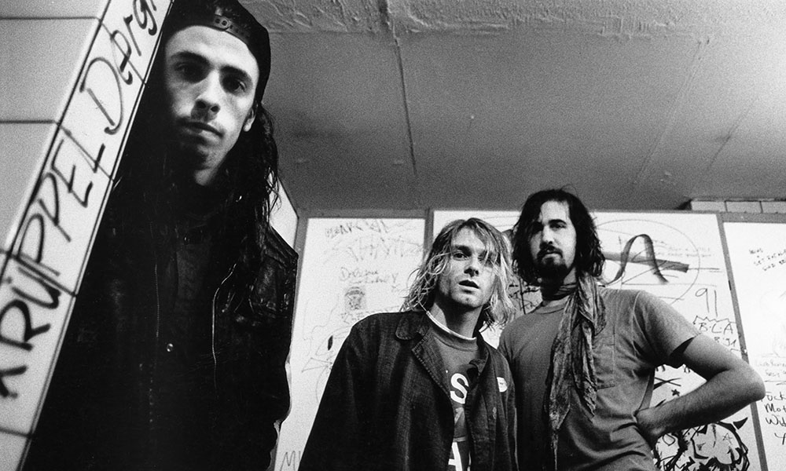
CHAPTER 06
Grunge: Raw, Authentic, Revolutionary
The Seattle Sound Explodes
Grunge emerged from Seattle's underground scene in the late 1980s as a reaction against the excesses of 1980s hair metal. The gray skies of Seattle mirrored the brooding, introspective sound of this new movement—raw, unpolished, and deeply authentic.
Mark Arm of Green River (later Mudhoney) is credited with first using the term "grunge" in 1981. The music combined punk's aggression with metal's heaviness, creating a sound that was both abrasive and melodic.
The Big Four of Grunge
NIRVANA
The Voice of a Generation
Nirvana
Pearl Jam
Kurt Cobain, Krist Novoselic, Dave Grohl
Eddie Vedder, Mike McCready, Stone Gossard
"Nevermind" (1991) changed everything. "Smells Like Teen Spirit" became the anthem of Generation X.
"Ten" (1991) showcased emotional depth and social conscience. "Jeremy," "Alive," "Black."
The Nevermind Revolution
September 24, 1991: Nirvana releases "Nevermind." The album's unexpected success brought grunge—and alternative rock—into the mainstream overnight.
Soundgarden
Alice in Chains
Chris Cornell, Kim Thayil, Ben Shepherd
Layne Staley, Jerry Cantrell, Mike Starr
"Badmotorfinger" (1991) merged metal riffs with classic rock songwriting. "Black Hole Sun."
"Dirt" (1992) explored dark themes with haunting harmonies. "Man in the Box," "Rooster."
"Smells Like Teen Spirit" became an anthem for disaffected youth worldwide. The music industry was transformed, with major labels scrambling to sign Seattle bands.
"Here we are now, entertain us."
— Nirvana, "Smells Like Teen Spirit"
Dirty Tones
Alienation
Flannel Fashion
Authenticity

Slide 19
CHAPTER 06
Alternative Rock Explosion
Beyond Grunge
Alternative Rock Subgenres
While grunge dominated the early 1990s, alternative rock encompassed a much broader spectrum of sounds and styles. From the experimental art-rock of Radiohead to the geek-rock charm of Weezer, alternative rock proved that rock could evolve in countless directions while maintaining its rebellious spirit.
Britpop
Pop Punk
Oasis, Blur, Pulp
Green Day, The Offspring, Blink-182
British response to grunge, catchy melodies, working-class pride
Punk energy with pop hooks, youth themes
College radio stations and the Lollapalooza festival (launched 1991) became crucial platforms for promoting alternative acts, helping bands reach audiences outside the mainstream.
Industrial Rock
Ska Punk
Nine Inch Nails, Ministry
Sublime, No Doubt, Reel Big Fish
Electronic elements, dark, mechanical sound
Ska rhythms mixed with punk energy
Key Alternative Rock Bands
Radiohead
"OK Computer" (1997) - Experimental, complex, groundbreaking
Lollapalooza: The Alternative Festival
Weezer
Launched in 1991 by Jane's Addiction's Perry Farrell, Lollapalooza became the premier showcase for alternative rock. The touring festival introduced audiences to diverse acts and helped alternative rock reach mainstream success.
"Blue Album" (1994) - Geek rock, catchy hooks, relatable lyrics
Red Hot Chili Peppers
The festival's eclectic lineups reflected alternative rock's diversity, featuring everything from grunge and industrial to hip-hop and electronic music.
Funk-rock fusion, energetic live shows
Smashing Pumpkins
"Siamese Dream" (1993) - Layered guitars, emotional intensity
1991
30M+
Gen X
Alanis Morissette
Lollapalooza debuts
"Nevermind" sales
Generation defined
"Jagged Little Pill" (1995) - Feminist rock, raw emotion

Slide 20

07
CHAPTER SEVEN
INDIE ROCK
REVIVAL
2000s-2010s: Return to Raw, DIY Aesthetics

Slide 21

CHAPTER 07
The Garage Rock Revival
Back to Basics
The 2000s and 2010s saw a revival of indie and garage rock, with bands drawing inspiration from the DIY and underground scenes of the past. This resurgence brought a fresh wave of independent and alternative rock music characterized by raw energy and authenticity.
The movement was defined by a DIY ethos—many bands self-released music and embraced a lo-fi sound. Independent record labels flourished, and scenes developed in cities like New York, Brooklyn, and London.
INDIE ROCK
Key Indie Revival Bands
Live Performance Energy
The Strokes
Arctic Monkeys
New York, 1998
Sheffield, 2002
DIY Aesthetics
"Is This It" (2001) - Kicked off the revival. Post-punk influences, stylish image
"Whatever People Say I Am..." (2006) - UK indie explosion. Witty lyrics, energetic sound
Independent Labels: Domino, Merge, Sub Pop
The White Stripes
Yeah Yeah Yeahs
Lo-fi Production: Embracing imperfections
Detroit, 1997
New York, 2000
Self-Release: Bands controlling their music
"Elephant" (2003) - Raw blues-influenced garage rock. Jack & Meg White duo
"Fever to Tell" (2003) - Art-punk energy. Karen O's explosive stage presence
Festival Culture: Coachella, Lollapalooza, SXSW
Interpol
Vampire Weekend
Diverse Influences
New York, 1997
New York, 2006
Indie revival bands drew from post-punk, new wave, garage rock, and even world music, creating a rich tapestry of sounds that proved rock's continued vitality.
"Turn on the Bright Lights" (2002) - Post-punk revival. Dark, atmospheric
Self-titled debut (2008) - Indie rock meets African rhythms. Preppy aesthetic

Slide 22

08
CHAPTER EIGHT
LEGACY &
CULTURAL IMPACT
Rock's Enduring Influence on Music & Culture

Slide 23

CHAPTER 08
Rock's Cultural Revolution
More Than Music
Rock music has been far more than just a genre—it's been a cultural force that shaped fashion, youth identity, social movements, and global culture. From the rebellious spirit of the 1950s to the grunge revolution of the 1990s, rock has consistently challenged norms and given voice to generations seeking change.
Rock became a symbol of freedom, rebellion, and self-expression. It broke down racial barriers, fueled countercultural movements, and provided the soundtrack for social revolution.
Cultural Impact Areas
Fashion
Youth Culture
ROCK FOREVER
From leather jackets and blue jeans to flannel shirts and ripped jeans, rock fashion became a universal language of rebellion and identity
Rock gave teenagers a voice and identity, creating generational bonds and empowering youth to challenge authority
The Crowd Unites
Influence on Other Genres
Social Movements
Global Influence
Hip-Hop: Sampling rock tracks, shared rebellious spirit
Civil rights, anti-war protests, feminism—rock provided the soundtrack for social change and political activism
Rock transcended borders, creating a universal language that connected people across cultures and continents
Pop Music: Rock's emotive power and stage presence
Electronic: Rock's energy in EDM and dance music
Country: Rock-influenced country rock and alt-country
"Rock and roll is here to stay."
— Danny & the Juniors, 1958
Influenced All Genres
Symbol of Freedom
Emotional Connection
Timeless Legacy

Slide 24

ROCK WILL
NEVER DIE
From blues roots to global phenomenon, rock music has constantly evolved while maintaining its rebellious spirit. Its influence echoes through every genre that followed, proving that authentic, passionate music transcends time.
From Chuck Berry's guitar riffs to Kurt Cobain's raw emotion, from The Beatles' revolution to Arctic Monkeys' revival—rock continues to inspire, challenge, and unite generations.
70+
∞
Billions
Forever
Years of Rock
Influence
of Fans
In Our Hearts

